Slide 1
Welcome to Northwood School
Transition Information Evening 2023

Slide 2
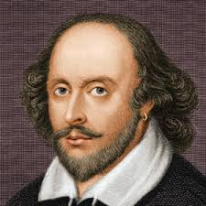
“Be not afraid of greatness; some are born great, some achieve greatness, and others have greatness thrust upon them.” — William Shakespeare
Welcome to Northwood school,
We are looking forward to welcoming not only your child but your whole family to our school community.
This evening your will hear from :
Mr Shah - Headteacher
Ms Foskett - Assistant Headteacher
Ms Barry - Head of Year 7

Slide 3
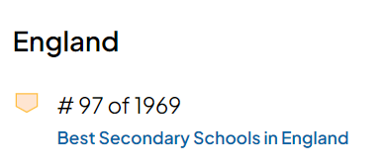
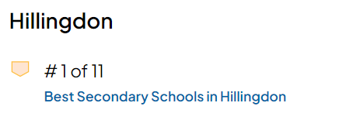
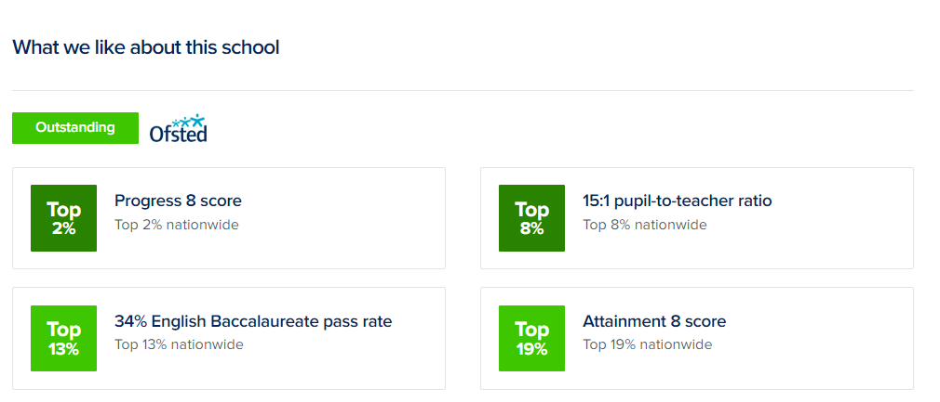
Top 5% in the country

Slide 4
What does Ofsted and parents say…
ACHIEVEMENT THROUGH SUPPORT
We are so thankful that our child was able to attend Northwood. Yes, you are a fantastic school in terms of grades but for us it has been the care that you have given our child that truly stands out. It has gone beyond a duty of care and I will never be able to thank you all enough.
Parents speak admiringly of the school and recognise the efforts of staff to ensure that their children thrive and achieve.
Pupils make exceptional progress in all year groups and in almost all subjects. Disadvantaged pupils and those who have special educational needs (SEN) and/or disabilities also make strong progress.
The curriculum is rich, offering a range of academic and vocational courses and extracurricular programmes.
Pupils’ behaviour and attitudes to learning are exemplary.

Slide 5
Year 7 Vision - Ms Barry
Here at Northwood, our students are accepting and considerate members of our community, they represent themselves, their family and the school in a positive manner.
My vision is for all Year 7 students to be here & actively engaged in their learning, happy in themselves, both physically and mentally healthy, honest in all they do and helpful in the school community.
The 5 H’s of Year 7:
Here
Happy
Healthy
Honest
Helpful

Slide 6
Year 7 Vision - Ms Barry
Opportunities of starting secondary school:
Meet new friends. Discover new hobbies and interests. Experience new subjects, teachers and knowledge. Embracing all these opportunities will help your child build their confidence.
Form time and house system:
Your child’s form group links with their house (RECIPE)
Form tutor will be the main contact point for students and parents.
Form tutor to support with wellbeing, behaviour, equipment and uniform checks, daily check in each morning, any worries or questions, promote inclusivity and supportive daily environment.
Points of contact for questions or concerns
School office, form tutor, subject teachers

Slide 7
The Year 7 Form Tutor Team
Head of Year 7 Ms Barry
7R Ms Zarshoy
7E Ms Balanica
7C Ms Greco
7I Ms Richardson
7P Ms Riaz
7EN Mr Pattni
Your child will see your form tutor every morning for registration and they will also teach them PSHCE once a week (Personal, Social, Health and Citizenship Education).
As Head of Year 7, I will work very closely with all the form tutors and will be here to help and support you and your child through their school career.

Slide 8
What is our RECIPE for success?
Students receive RECIPE points from their teachers when they show any of the RECIPE traits at Northwood
This stands for:
Resilience- the ability to recover quickly from difficult or tough situations. (Rosa)
Engagement- the amount of attention, curiosity, interest and passion that you show when you are learning (Edison)
Co-operation- The action of working together considerately and positively (Chadwick)
Independence- being responsible for your own actions and decisions (Isaac)
Pride- a feeling of happiness from your achievements and efforts (Pele)
Enthusiasm- Enjoyment and excitement shown when learning and discovering (Ennis)

Slide 9
What can I do to support my child?
We’re all in this together: Remind your child that everyone is in the same boat when they start. Talk to them about ways to initiate conversation if they find this difficult.
Friendships: Remember friendships take time to develop: don’t panic if they haven’t made a friend immediately.
Extracurricular: Encourage them to join clubs and become involved in school life. This can be a good way to make friends with pupils in other forms and year groups.
If you are still concerned by half term, make contact with your child’s form tutor. They should know their form well by then, and may be able to give some suggestions and will have noticed if there are any specific problems.

Slide 10
Achievement Through Support
A Northwood Learner
Your child will go from one consistently good lesson to another…
They will have access to extensive careers education.
Technology
Attendance & Punctuality
Developing character
Time management
Preparing for assessment
Wellbeing
Active learning
They will have the opportunity to take part in a vast extra curricular programme…
They will have excellent pastoral support.
We have an individualised approach to each child
How can you support us?

Slide 11
The School Day
08:25 – 08:30 Student line up
08:30 – 09:00 Registration/assembly
09:00 – 10:00 Period 1
10:00 – 10:20 BREAK (designated area)
10:20 – 11:20 Period 2
11:20 – 12:20 Period 3
12:20 – 13:00 LUNCH (designated area)
13:00 – 14:00 Period 4
14:00 – 15:00 Period 5
15:00 – 16:00 Extra-curricular activities
We encourage all Year 7s to take part in at least 2 extra-curricular clubs per week…

Slide 12
Designated zone - Hall and Amphitheatre
Library Toilets
Year 7 only
(use east end stairs)

Slide 13
Equipment
Students are expected to bring the following equipment labelled and in a pencil case:
2 black/blue pens
1 green pen
2 pencils
ruler
calculator (Casio FX-83GTX or FX-991EX)
Protractor
glue stick
mini whiteboard and pen (which can be purchased from parent pay)
2b pencil for art
highlighter pens
coloured pencils
Plus:
Timetable
Reading book
Water bottle
All items can be bought at our Library

Slide 15
Uniform Suppliers
Pullens
50 High Street, Northwood, HA6 1BL
Angels Uniforms
317 Rayners Lane, Pinner,
HA5 5EH
Adams School Clothing
55 Victoria Road, Ruislip Manor,
HA4 9BH

Slide 16
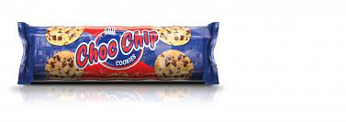
Banned Confectionery
Sweets, crisps & drinks in school
The following items of confectionery are banned in our school:
Fizzy drinks
Energy drinks
Large (share sized bags) of crisps
Large (share sized bags) of sweets
Whole packets of biscuits

Slide 17
Northwood Sanctions
40 min HOY sanction
Uniform Infringement (top button, make up, lack of house badge, incorrect footwear, shirt untucked, incorrect bag)
Fizzy drinks, chewing gum
Poor organisation (equipment)
Use of mobile phone
Lates (every 3 lessons)
40 min HOD Sanction
Continued homework issues
Continued poor ATL in lesson-2 warnings
Persistent organisational issues
60 min LG Sanction
Missed HOY/HOD sanction
Removal from lesson (3 warnings) and Defiance
Swearing (if at a member of staff then FTE/internal FTE)
Play-fighting
Internal
Missed LG detention
Fighting (Possible FTE depending on seriousness)
HoY/AHT concerns
2 removals in a week
2 removals in a day is a FTE

Slide 18
Attendance & Punctuality - Ms Foskett
What do you think of when you see

Slide 19
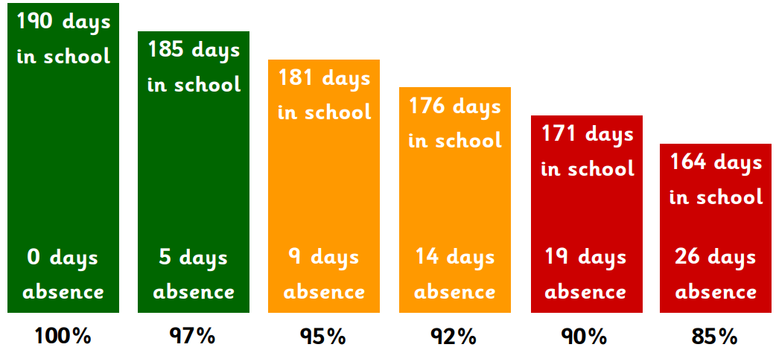
What does 90% attendance mean?

Slide 20
How can a couple of days have an impact?
Attendance During One School Year (190 days) | Equivalent Days/ | Equivalent Weeks | Equivalent Year 11 Lessons Missed
98% | 3 Days | Over half a Week | 18 Lessons
97% | 5 Days | 1 Week | 27 Lessons
95% | 10 Days | 2 Weeks | 60 Lessons
90% | 19 Days | 4 Weeks | 120 Lessons
85% | 28 Days | 6 Weeks | 180 Lessons
Students with attendance <90% are persistently absent students
Consider the impact of missing so many lessons
Punctuality is also key!

Slide 21
Safeguarding
Your child’s safety in and out of school is our main priority. We want our entire Northwood School community to feel safe and happy.
How do we keep your child safe?
Strict routines in place
Behaviour plan
Fire drills / lockdown drills
Designated Safeguarding leaders
CCTV (in and around school site)
Secure premises
Safe Schools Police officer
PSHCE lessons / form time / assemblies
Worry Boxes
Pastoral team
Staff training
Recent parent survey showed that 96% of parents agree their child feels safe at Northwood School.

Slide 22
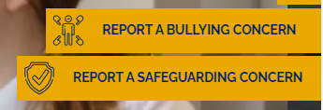
Safeguarding
Form Tutor
Any Teacher
Head of Year
Teaching Assistants
Ms Jackson - medical
Our School Counsellors
Ms Rafferty (AHT)
Ms Hosty (AHT)
Mr Singer (AHT)
Ms Olivier (DHT)
Mr Shah (HT)
Ms Kahn (Designated Safeguarding Lead)
Ms Foskett (Deputy Designated Safeguarding Lead)
Mr McManus (Deputy Designated Safeguarding Lead)
nort
Use the blue ‘Worry Box’ on each floor
OR
Report a concern using our online form

Slide 23
How can I support my child?
Travelling to school by themselves.
Have several trial runs of their new journey, building up their level of independence gradually.
Consider downloading an app which allows you to track where they are (such as ‘Find My Friends’) – also useful picking them up after school trips.
Arrange for them to travel with a friend and allow plenty of time.
Keep emergency phone numbers in their bag, in case they lose their phone and need to contact you.

Slide 24
Important upcoming events
Students will receive an information / activity pack in the post by the end of July.
Arrangements for the start of term - parent letter.
Summer School (24th-28th July) - information will be sent out this week.
5th September - 1st day of term. Arrive no later than 08:25 (gates open at 08:10).
Year 7 Information Evening is on the 19th September at 6pm
Phone Surgery - Friday 7th July 10:00-12:00
https://www.northwood-school.org.uk

